Slide 1
ONLINE SHOPPING MAD 3115
Chaitali Patel
(C0697976)

Slide 2
Introduction
In my application, it contain some view controller and some business file.
It is application which is form of electronic commerce which allow to customer shop cloth online.
This store provide different kind of clothes.
The main flow diagram of my application is defined below.

Slide 3
Basic Block Diagram

Slide 4
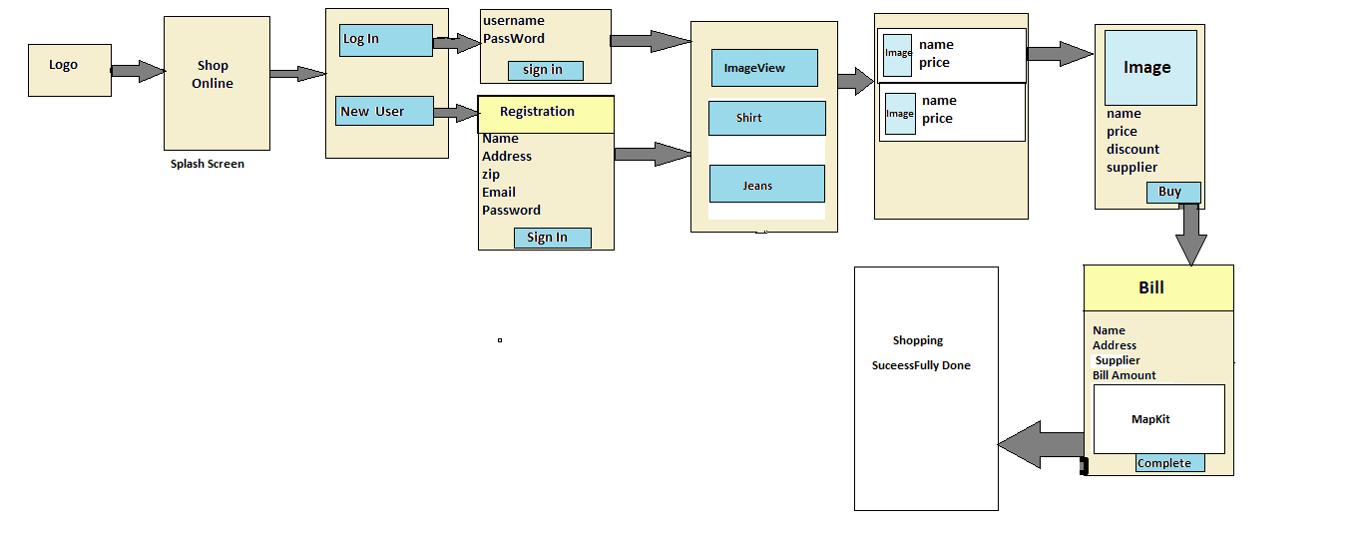

Slide 5
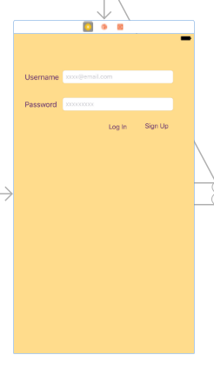
Login View Controller

Slide 6
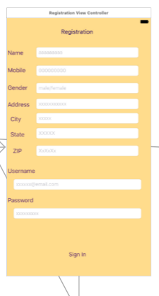
Registration View Controller

Slide 7
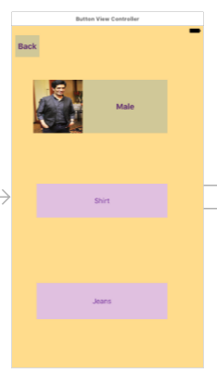
Button View Controller

Slide 8
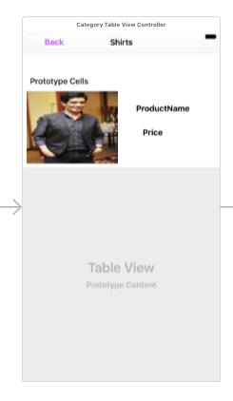
Category Table ViewController

Slide 9
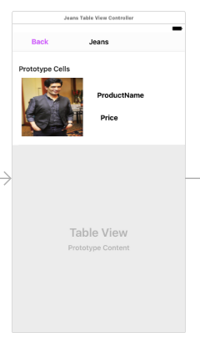
Jeans Table ViewController

Slide 10
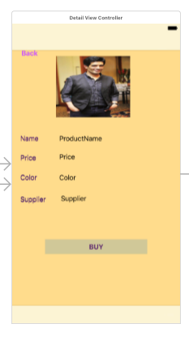
Detail View Controller

Slide 11
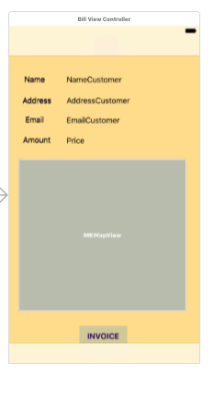
Bill View Controller

Slide 12
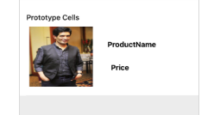
Category Table ViewCell

Slide 13
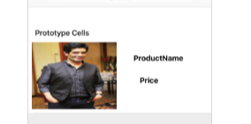
Jeans Table ViewCell

Slide 14
Business File
1.Login.Swift
This is file which contain username and password for login to customer.
If customer has not username and password then he/she goes to Registration File.
2.Registration.Swift
In this file,User can generate his/her username and password with the personal detail.

Slide 15
After the registration he/she can login with their username and password.
3.Detail.swift
In this file it contain data about the products it contain price,supplier etc.
It connected with the getter setter method to call detail about product in detail view controller.
This file contain data of product which product are available in the store.

Slide 16
4. Bill.Swift
This file contain data regarding customer that buy a product.
This file has a map view which contain the customer’s address shown on the map for easy to supply product.
This application has payment system is Cash On Delivery.

Slide 17
Thank You

